Slide 1
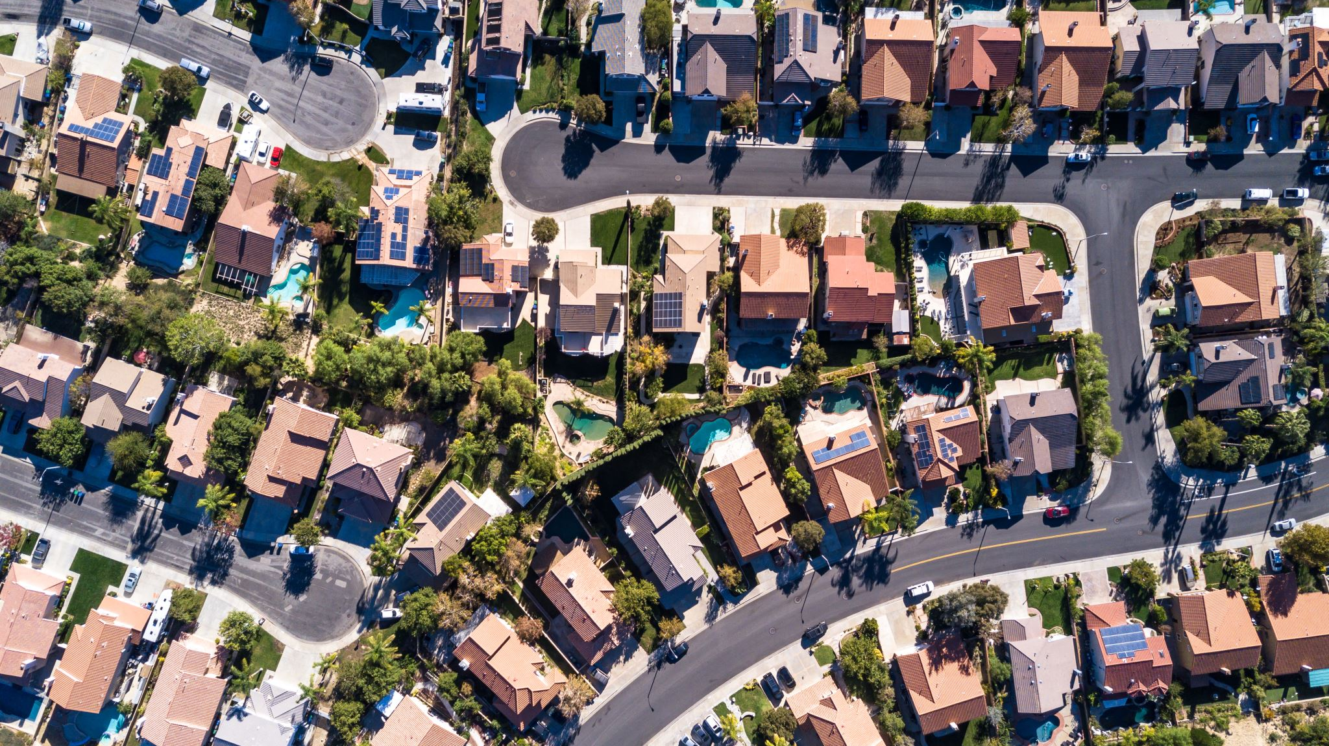
Housing Prices in Los Angeles
Team 2: Louis Banegas, Marc Calvillo, Christian Momdjian, Joshua Ng, Adrian Soriano

Slide 2

Introduction
Our project uses HDFS, Hive, and PowerBI. Its purpose is to filter and visualize housing market data that has been sold in California.
The data used in this project contains homes currently on the market at the time the dataset was downloaded.

Slide 3
Introduction (cont.)
This specific dataset was chosen because it has been regularly updated and has a comprehensive collection of housing data from areas across the US.
It allows us to compare today's housing market prices and explore the wide gaps in property value between counties in Los Angeles, our specific focus for this project.
It also allows us to view and visualize the specific areas where property value is most affected and which areas have the most properties on the market.

Slide 4

Related Work
Why focus on housing?
Drastic changes in the market
Five of the top six cities with most expensive housing prices are in California
In terms of price increases year to year: California also tops the list. The bay area, specifically.

Slide 5
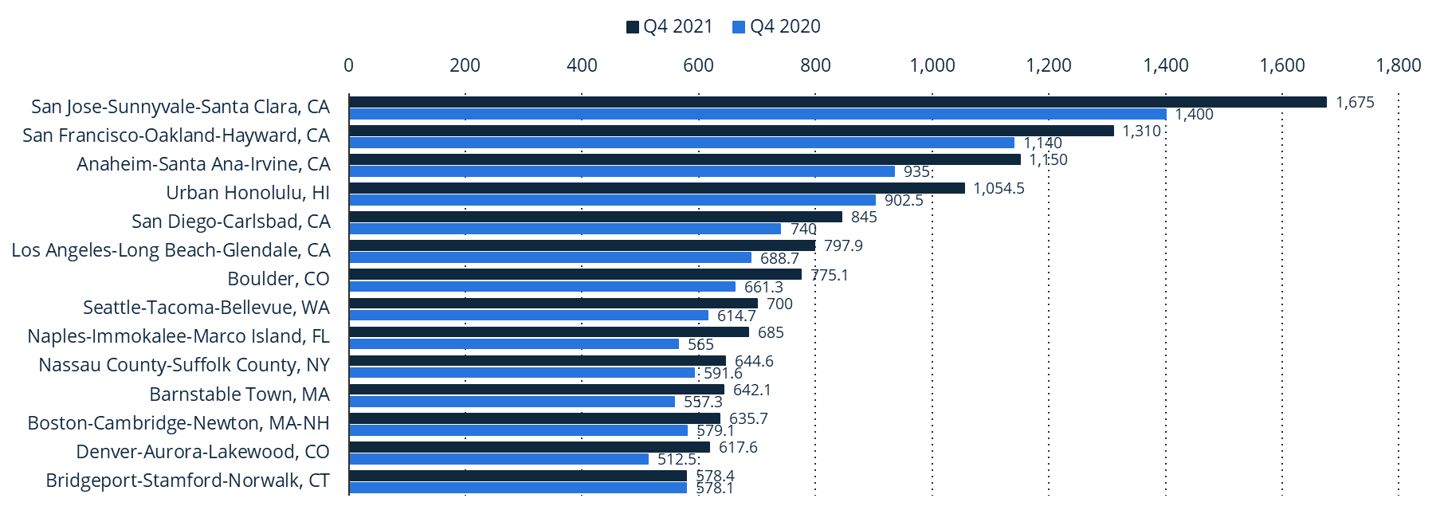
Median Sales Prices of Existing Single-Family Homes in the US

Slide 6
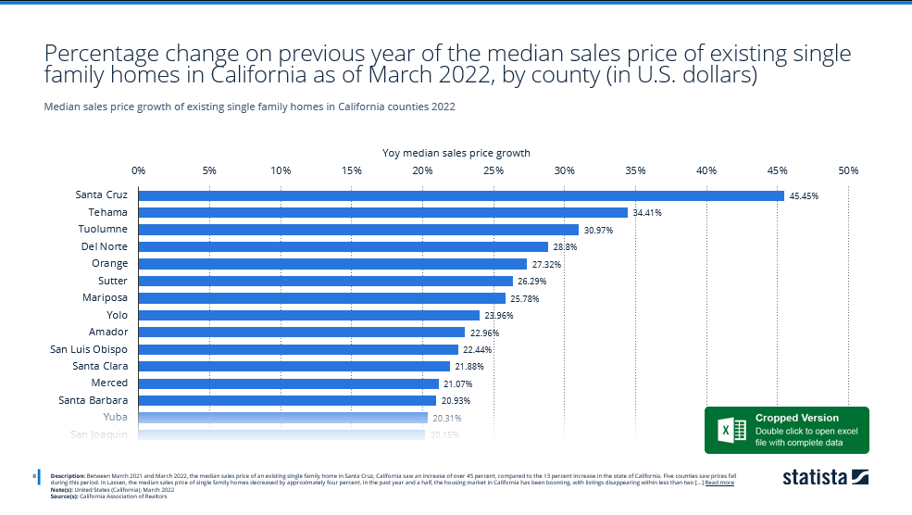

Slide 7
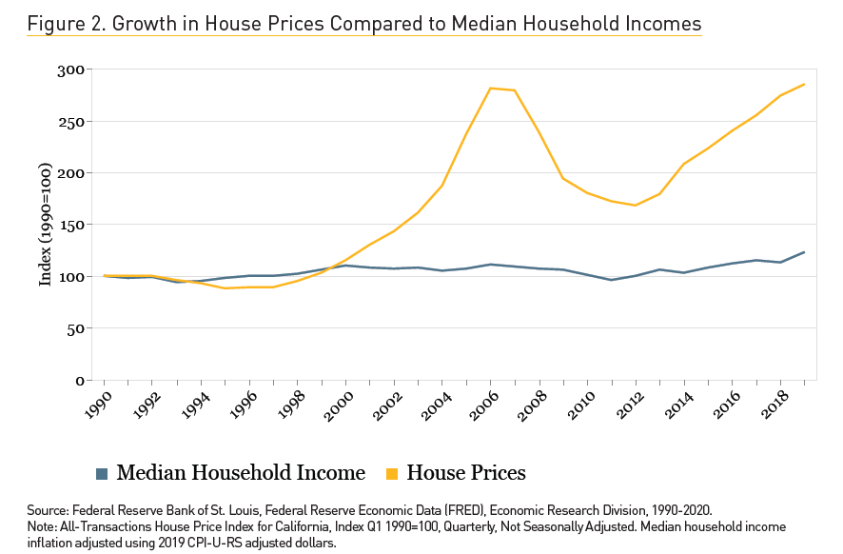
Prices on the Rise
Are prices higher due to higher wages?
House prices have increased 180%
Median Household income has increased 23%
Prices took a heavy dip during the recession, but continues a steady climb

Slide 8
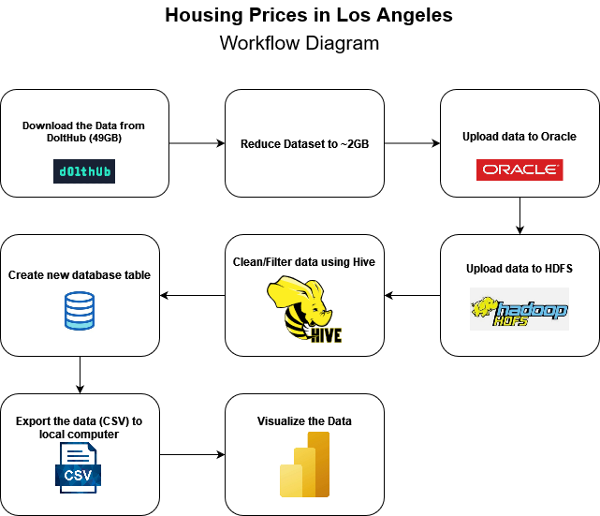
Workflow Diagram

Slide 9
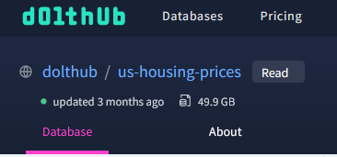
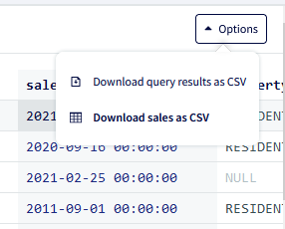
Preparing the Data
Complete dataset was pulled from Dolthub repository
Original dataset size was ~49GB
Couldn't be downloaded to Oracle cluster using wget
Downloaded part-file of dataset to reduce size to >2GB
Contains all CA housing price data we need as well as data from other states
Easier to work with

Slide 10
Preparing the Data (cont.)
Stored >2GB part-file in Dropbox location
Can download dataset into Oracle using wget
Easier to follow along in tutorial for other users
wget https://www.dropbox.com/s/3xt3up4fve78me8/dolthub_us-housing-prices_main_sales_REDUCED2.csv?dl=0

Slide 11

Cleaning the Data
Majority of cleaning/filtering was done through Hive (Beeline)
Needed only residential properties
Exclude vacant lots or commercial business properties
… AND (property_type LIKE '%RESIDENCE%' OR property_type LIKE '%CONDO%')
Removed unnecessary fields
Almost all CA data had some fields which were consistently empty or NULL
Ex. building_num_beds, building_num_baths, building_num_stories …
Created new database table and excluded these fields when exporting
Needed to pull records with realistic sale price
Some records had a sale_price of $100 or even $0.
Filtered by records with sale_price of $100,000 or more.

Slide 12

Using HDFS
The downloaded file called US housing prices was uploaded and stored in Oracle but before we could do anything we needed to rename it.
With it renamed, we could create a new directory in HDFS to hold the data, after the directory is created, we uploaded the CSV file into the HDFS "housing data" directory we just created, and then loaded it into a new table using Beeline.
HDFS allowed us to store it properly for filtering and prevented space from being taken up in the oracle cluster.
H/W specs (from lscpu & cat /proc/meminfo commands):
Oracle Cluster version: 3.1.2
5 nodes: 2 master nodes, 3 worker nodes
CPUs: 8, CPU speed: 1995.309 MHz Total Memory: ~61GB

Slide 13


Spreadsheet model
3D map function tool
Easy way to analyze and edit data
Simple way to import/export data
Lacked the ability to display over 1.5 million rows of data
Weak visualization filtering tools
Business intelligence tool
Customizable dashboards
Interactive and visually appealing graphs, charts, and dashboards
Faster data processing
Powerful filtering tools for visualizations
Ability to download charts and graphs through an online market

Slide 14
Housing Visualization
The data queried is loaded into PowerBI for analysis
First attempt involved using every specific address for every property
Created a far too messy visual
Cities in Los Angeles County were used instead to visualize the data across the region
Entries for the city of Los Angeles were excluded
The first visualization shows the Average Property Values per City.

Slide 15
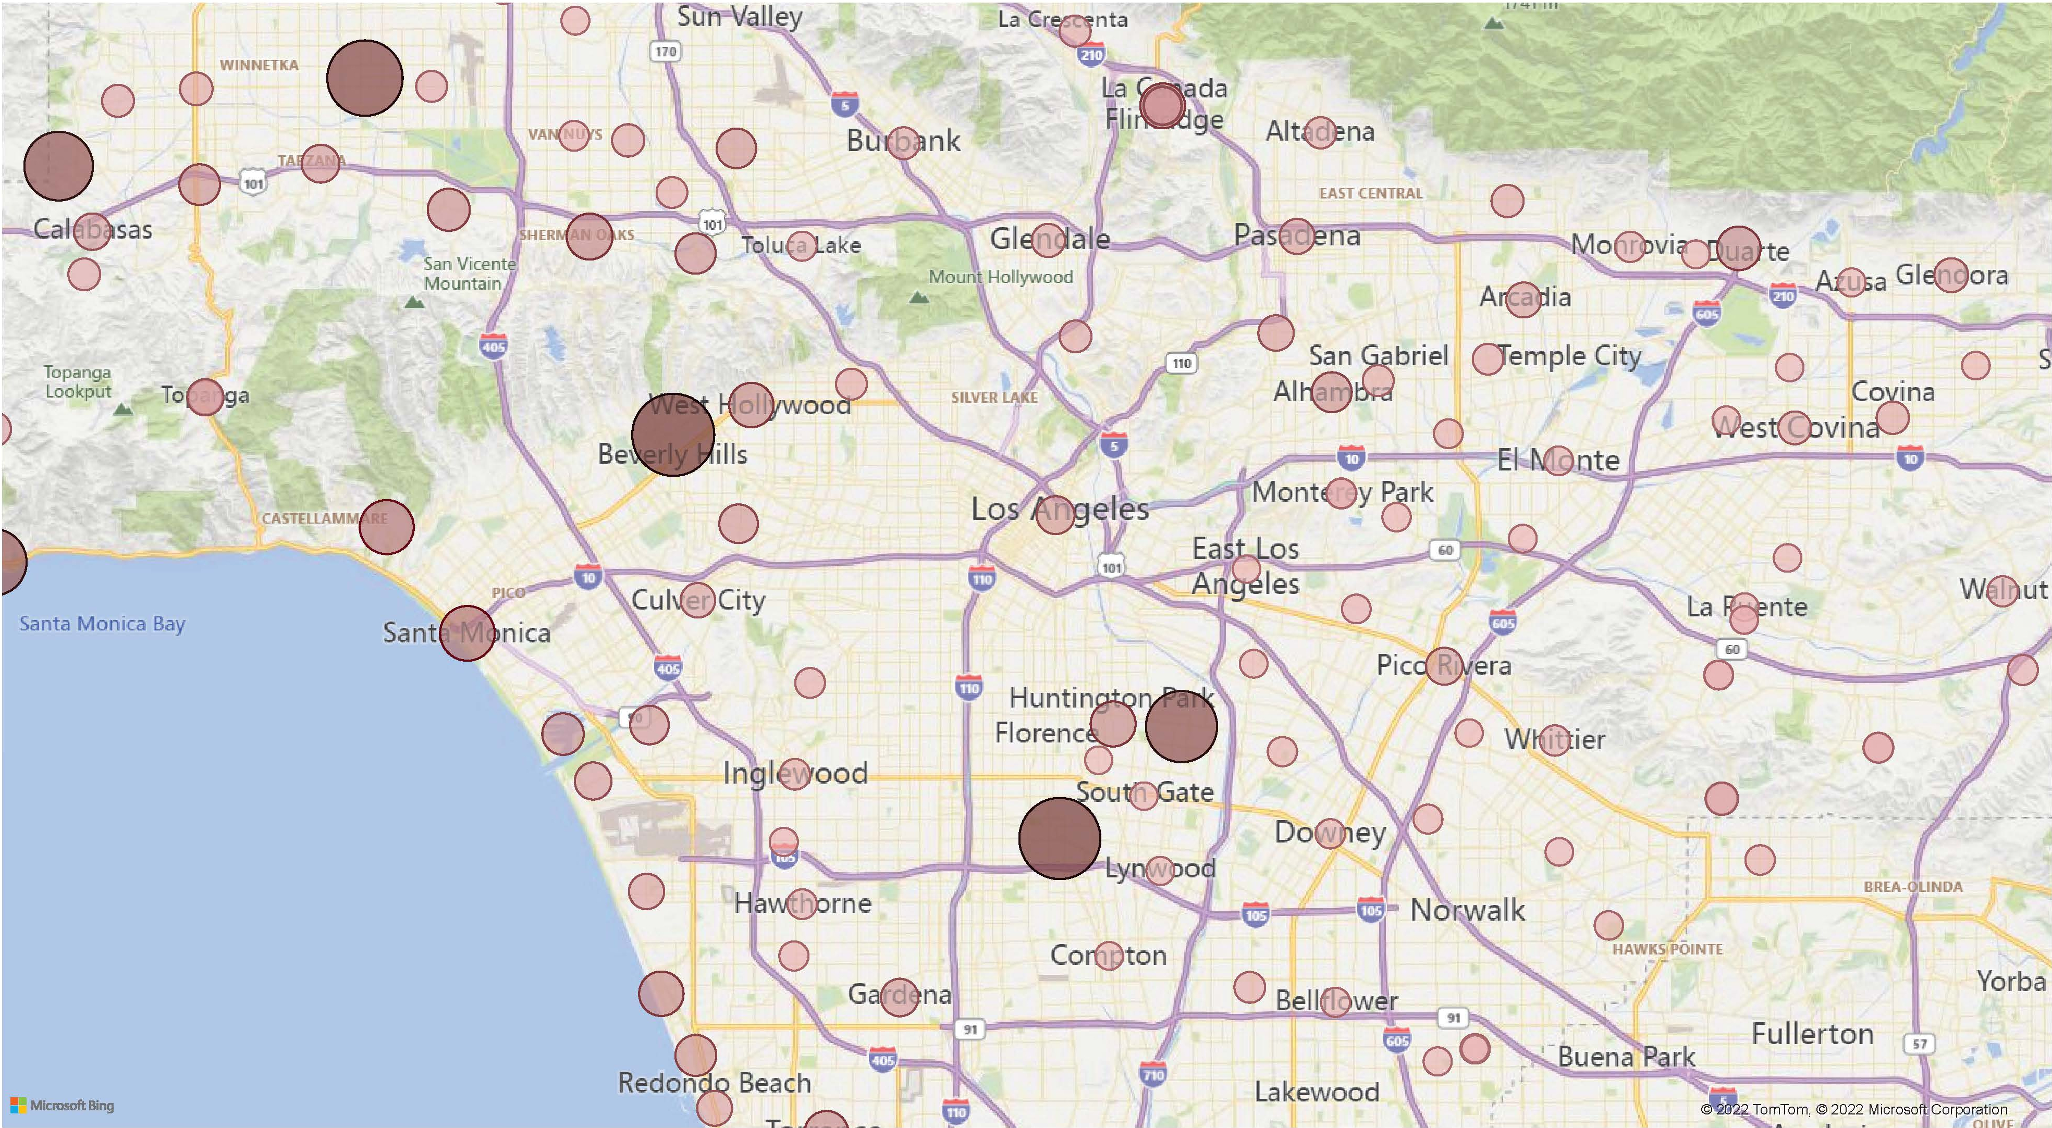
Average Housing Prices per City in Los Angeles County

Slide 16
Average Housing Prices per City in Los Angeles County (cont)
Beverly Hills has the highest average cost for housing
Avg Beverly Hills home > $10,000,000
Reseda is a close second
Avg Reseda home > $8,000,000
What areas hold a high concentration for unsold homes?

Slide 17
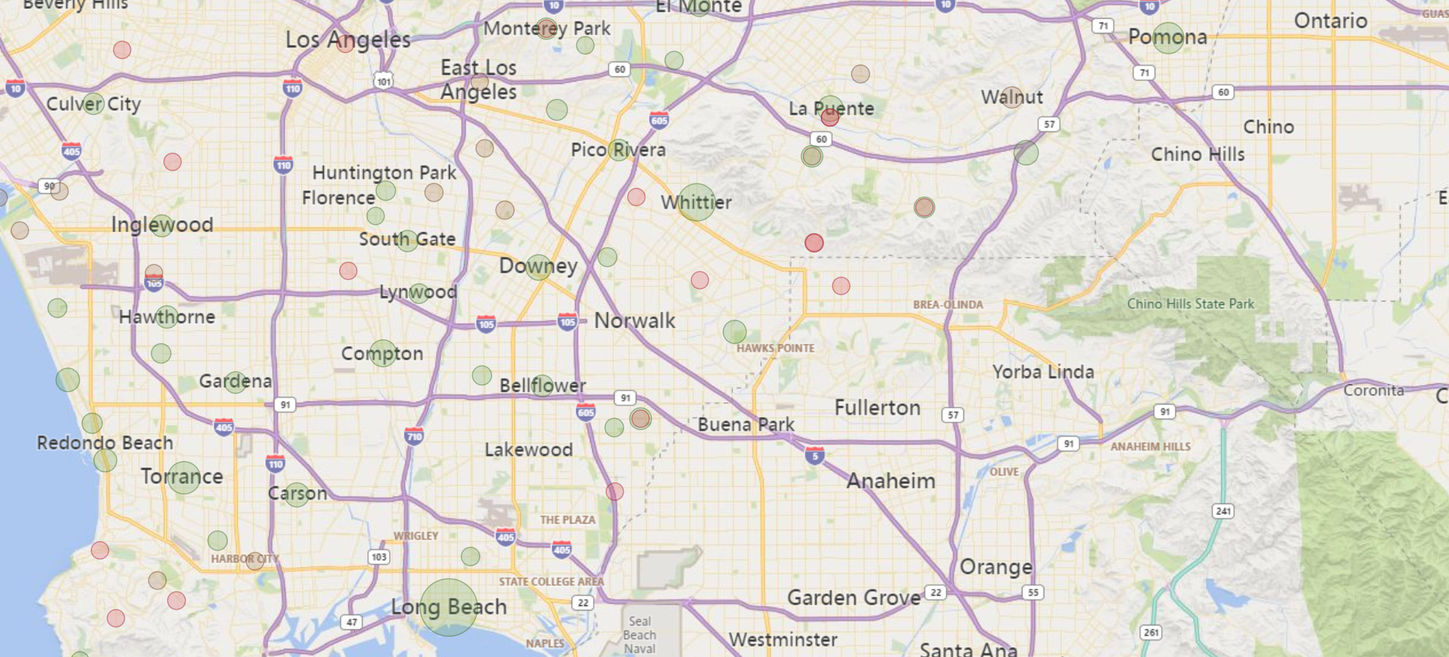
Number of Properties for Sale in Each City

Slide 18
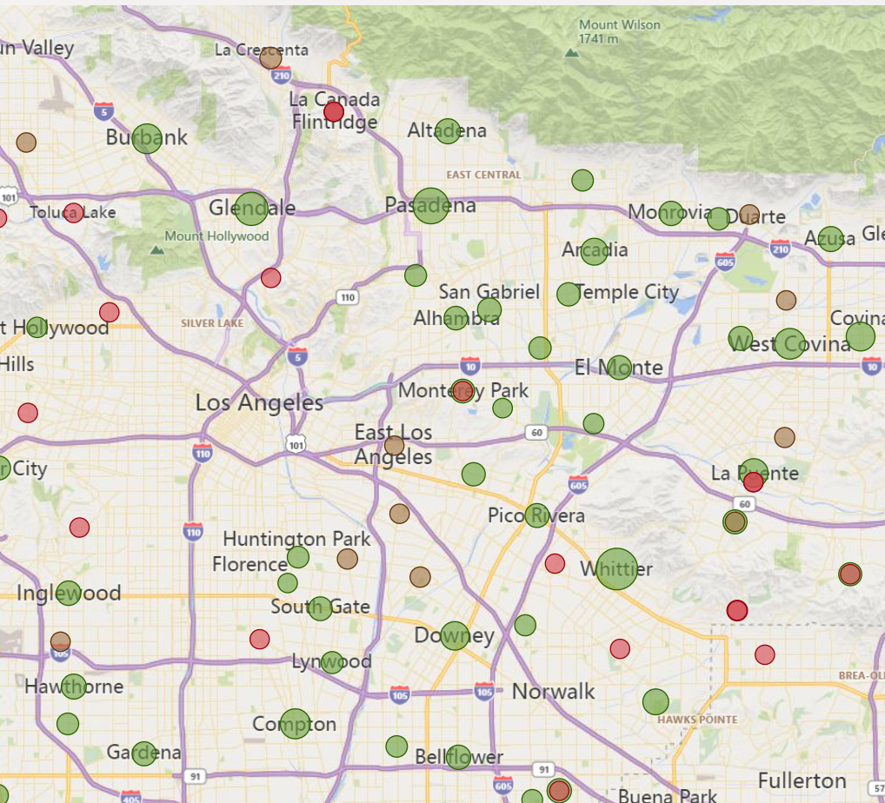
Number of Properties for Sale in Each City
Most properties for sale are:
Long Beach (7124)
Whittier (3554)
Torrance (2674)
Pasadena (2630)
Pomona (2462)

Slide 19
Conclusion
Utilizing tools such as HDFS, Hive, and Power BI, the data was reduced, cleaned, filtered, and visualized.
Visualizing the data showed us parallels to the work found in our references
There are 534 homes currently for sale in Beverly Hills with an average asking price of more than $10,000,000
Beverly Hills isn’t even one of the top cities with unsold homes
Even homes once considered affordable aren’t selling.
Our figures point to a larger issue
There are far too many expensive homes and not enough people with the wealth to buy them.

Slide 20
References
GitHub: https://github.com/cmomdji/CIS-4560-Team-2
DoltHub, Housing Data, DoltHub, 2022. Retrieved from: https://www.dolthub.com/repositories/dolthub/us-housing-prices/data/main
Statista, Residential Real Estate in California, Statista, 2022. Retrieved from: https://www-statista-com.mimas.calstatela.edu/study/56661/california-residential-real-estate/
L. Liu, Mortgage Loan and Housing Market, Elsevier, 2022. Retrieved from: https://doi.org/10.1016/j.iref.2022.10.012
D. Garcia, S. Manji, Q. Underriner, and C. Reid, The Landscape of Middle-Income Housing Affordability in Calfornia, Terner Center for Housing Innovation, 2022. Retrieved from: https://ternercenter.berkeley.edu/wp-content/uploads/2022/04/Landscape-of-Middle-Income-Housing-Affordability-April-2022.pdf

Slide 21
Thank You

